Slide 1
CS47: Cross-Platform Mobile Development
Lecture 2B: View-Only Components and StyleSheets
James Landay
Ryan Chen
Julia Rose Chin
Nadin Tamer
Ruslan AlJabari
Alix Cui
Winter 2022
https://cs47.stanford.edu
Notes:
Share the pres: https://docs.google.com/presentation/d/1D91sdymiJY7yvYkVgBN5gKcCXw_lIbE6GfoNMDoN3mM/edit?usp=sharing
Record lecture!

Slide 2
Logistics
Assignment 1 due this Friday at midnight!
Submit via Canvas
Office hours have been posted to the website and Ed!
Sign up for a 1-on-1 timeslot via Calendly!
Also available by appointment via email/Slack

Slide 3
Recap...
Learning about JSX and RN
Our first Expo project!
Slides from last lecture

Slide 4
Today’s goals
What makes up a UI?
What are Components?🧱
How do we style our Components? 💅

Slide 5
Components 🧱
Different classes that inherit from the React Component class

Slide 6
Components 🧱
Different classes that inherit from the React Component class
Importance: renderable!

Slide 7
Components 🧱
Different classes that inherit from the React Component class
Importance: renderable!
Common Components:
View
Text
Image
Lists
Scrollviews
Touchables

Slide 8
Components 🧱
Different classes that inherit from the React Component class
Importance: renderable!
Common Components:
View
Text
Image
Lists
Scrollviews
Touchables

Slide 9
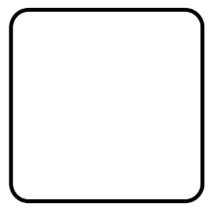


View
Most common visual styles
Common uses: wrapper around images, background, layout control
backgroundColor: “red”
borderWidth: 2
borderColor: “green”
borderRadius: 10
opacity: 0.3

Slide 10



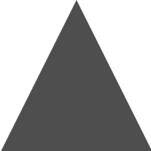
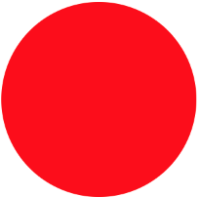
View
Using the different styles we can get pretty interesting shapes
Notes:
Questions?

Slide 11
Text
A basic text component that by default just looks like this:
In code it will look like this:
<Text>
This is a Text!
</Text>
This is a Text!

Slide 12
Text
Text can be customized in multiple ways
color: “red”
fontWeight: “bold”
fontSize: 16
fontFamily: “Helvetica”
backgroundColor: “black”

Slide 13
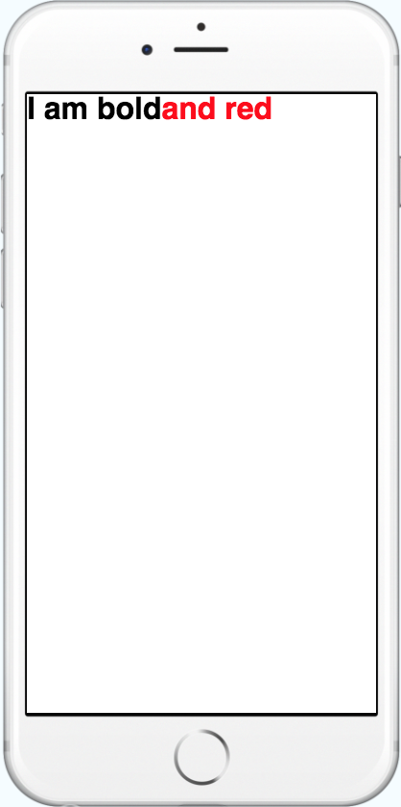
Text
Text allows nesting
<Text style={{fontWeight: 'bold'}}>
I am bold
<Text style={{color: 'red'}}>
and red
</Text>
</Text>

Slide 14
Text
Has an onPress and onLongPress handlers
<Text onPress=() => console.log(“bold clicked”)
style={{fontWeight: 'bold'}}>
I am bold
<Text style={{color: 'red'}}>
and red
</Text>
</Text>
Notes:
Questions?

Slide 15
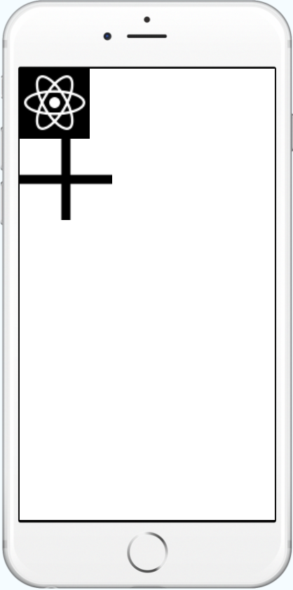
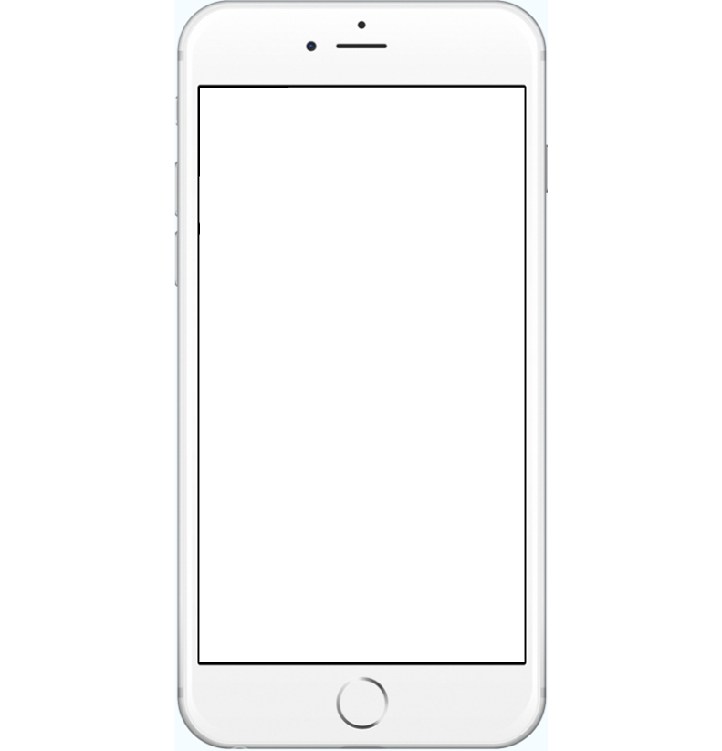
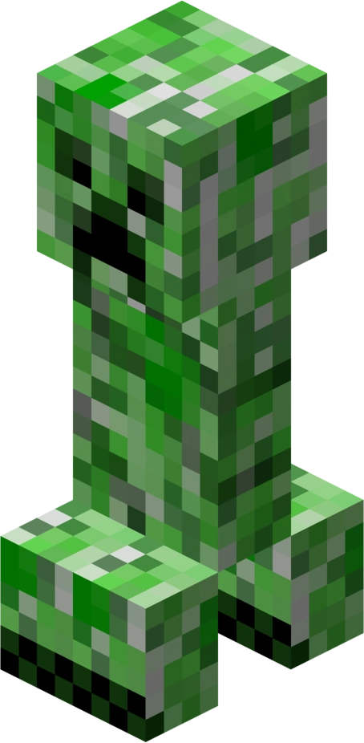
Image
It lets you display images!!
<Image source={require('/minecraft/creeper.png')}/>
As you see, not styling images can go wrong real fast… aww man.

Slide 16
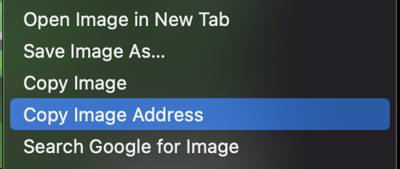
Image
Uses URI or Assets to display the photos
<Image style={{width: 100, height: 220}}
source={{uri: 'https://cool-minecraft-pictures
.com/creeper.png'}}/>

Slide 17
Image
Uses URI or Assets to display the photos
<Image style={{width: 100, height: 220}} source={require('/minecraft/creeper.png')}/>

Slide 18

Image
You can specify the resize mode of the image
<Image resizeMode=“stretch” source={{...}}/>
<Image resizeMode=“cover” source={{...}}/>
<Image resizeMode=“contain” source={{...}}/>
<Image resizeMode=“repeat” source={{...}}/>
Notes:
Stretch, doesn’t keep aspect ratio
Cover is like Crop
Contain is like fit
Repeat tiles
Questions?

Slide 19
Components 🧱
Different classes that inherit from the React Component class
Importance: renderable!
Common Components:
View
Text
Image
Lists
Scrollviews
Touchables
Notes:
So far so good?

Slide 20
Next, adding some style! 💅

Slide 21
Coordinates
Container: { position: ‘absolute’, start: 0, top: 0, width: 50, height: 50 . . . }

Slide 22
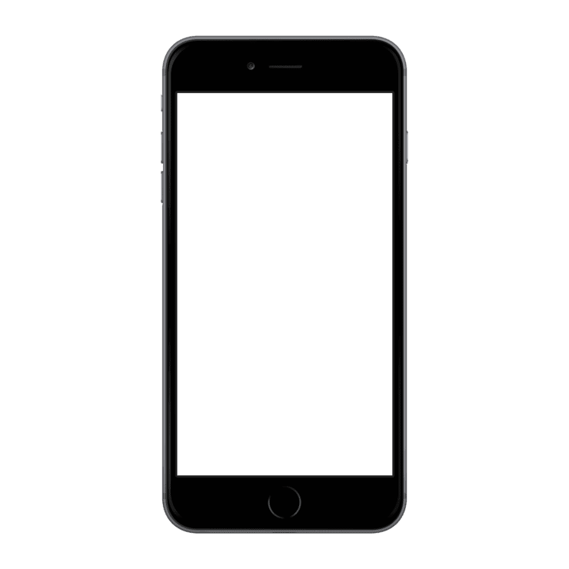
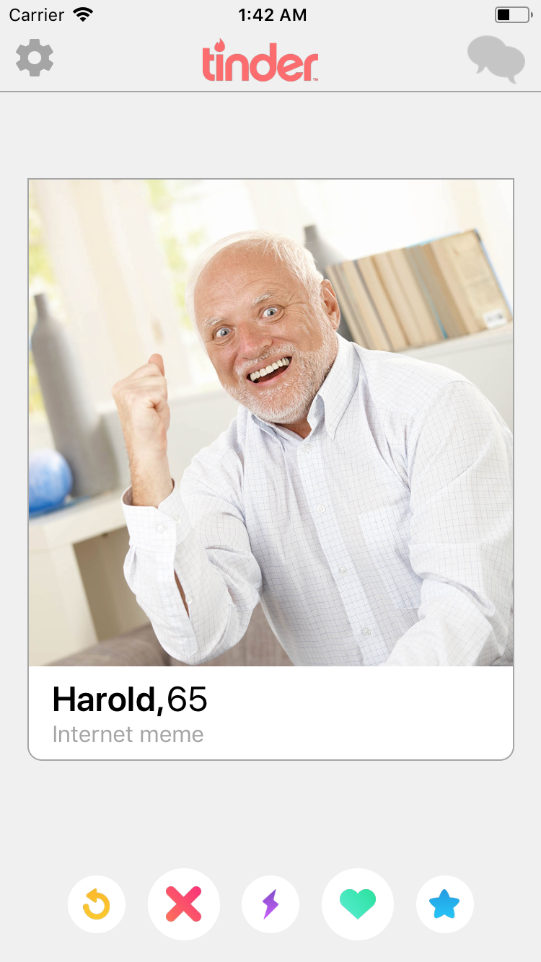
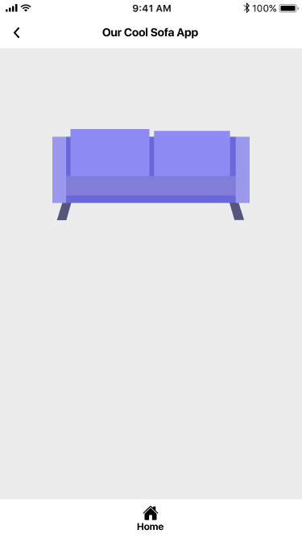
Coordinates

Slide 23
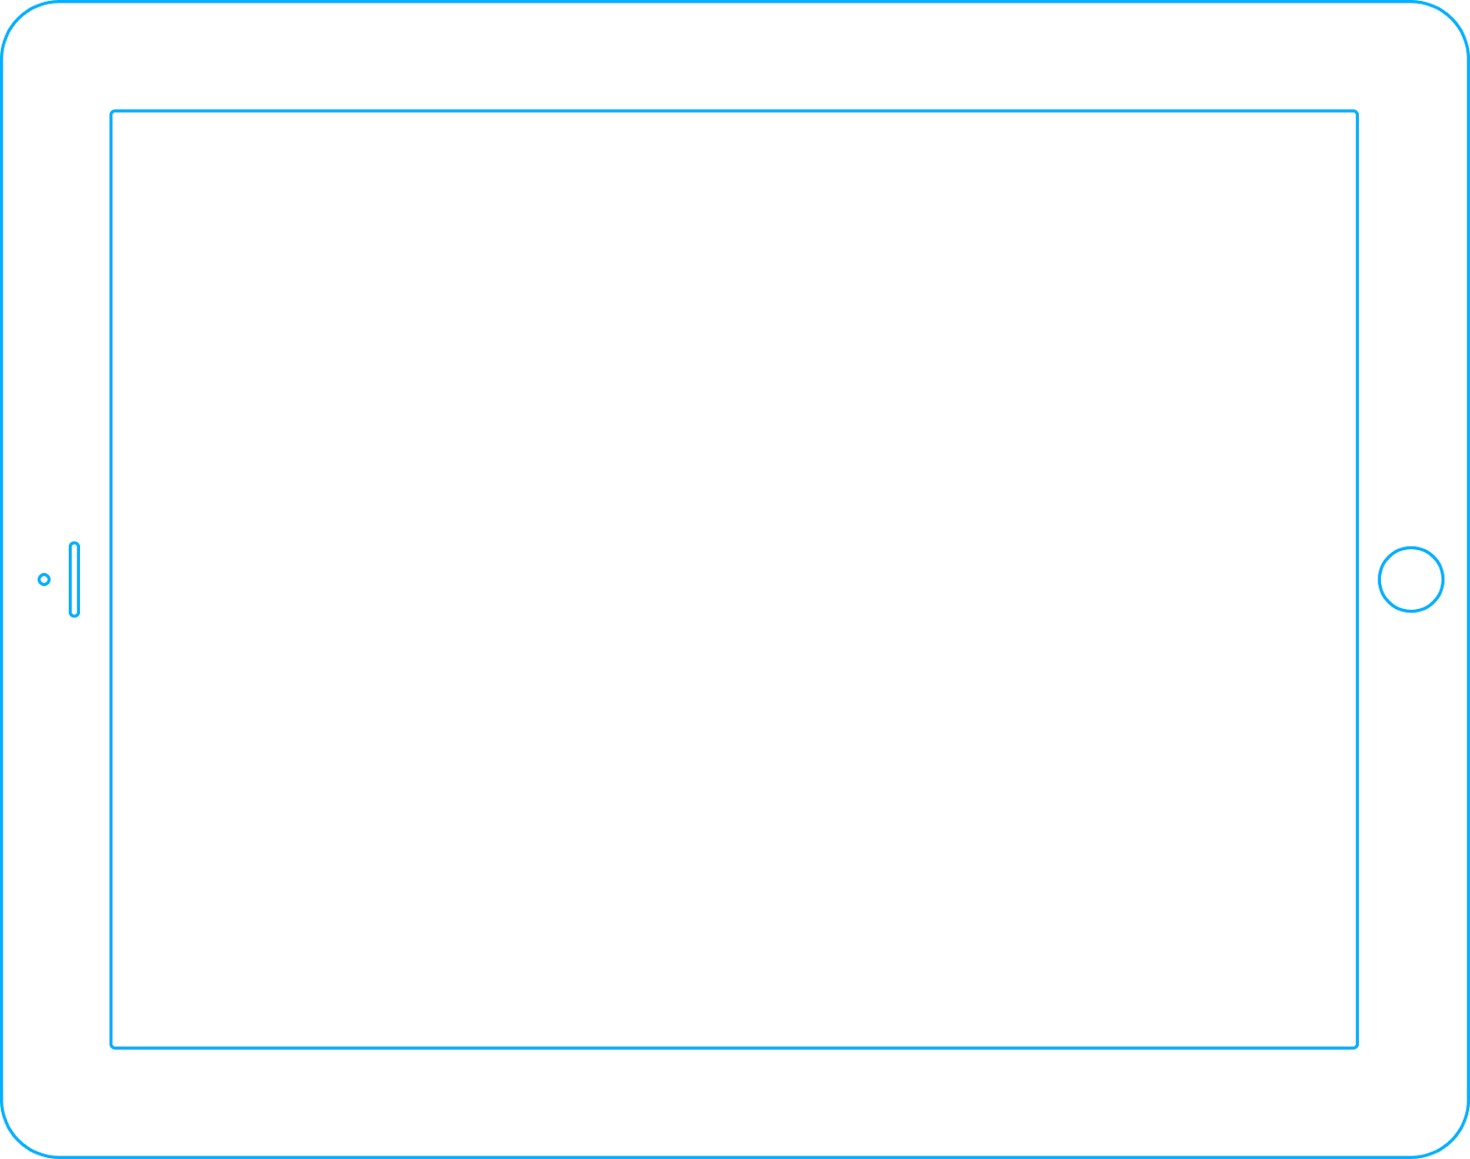
Coordinates
Notes:
No contact between child and parent

Slide 24
Relative, percentages
Container: { start: ‘10%’, top: ‘10%’, width: ‘5%’, height: ‘5%’ . . . }
Notes:
It is a pain to figure out the right percentages. What is absolute vs what is relative?

Slide 25
Relative, percentages
Notes:
It is a pain to figure out the right percentages. What is absolute vs what is relative?

Slide 26
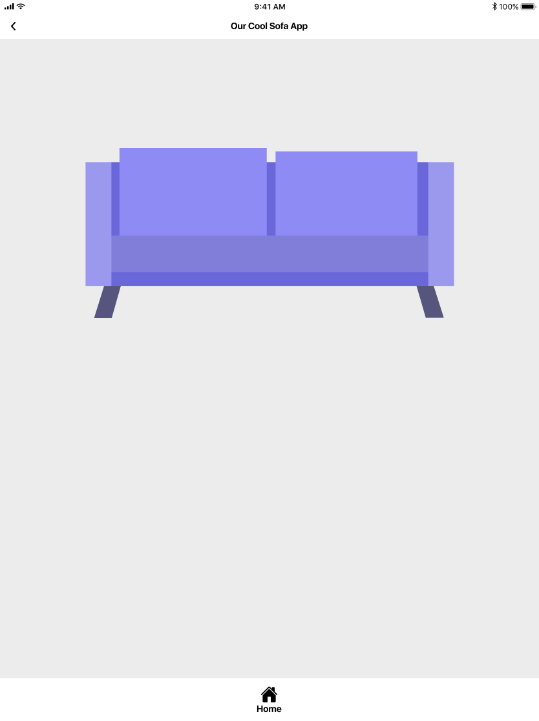
Relative, percentages
Notes:
It is a pain to figure out the right percentages. What is absolute vs what is relative?
Child to parent, but parent cannot change things about children

Slide 27
Relative, percentages
Appropriate margins?
Screen ratio change?
Safe area around?
Notes:
It is a pain to figure out the right percentages. What is absolute vs what is relative?

Slide 28
Flexboxes
Container: { justifyContent: ‘space-around’, alignItems: ‘center’, . . . }

Slide 29
Flexboxes

Slide 30
Flexboxes
Notes:
Worry about sizes, and we’ll worry about spaces.
Parent and child adjust based on each other.

Slide 31
Flexboxes
Property | Default | Options
flexDirection | column | row, column
justifyContent | flex-start | flex-start, center, flex-end, space-around, space-between
alignItems | stretch | flex-start, center, flex-end, stretch
http://www.reactnativeexpress.com/flexbox
Notes:
Show it with a demo: https://snack.expo.dev/@jrchin/lecture-2b-flex-demo

Slide 32
Break time! 🚽

Slide 33
Now it’s your turn!
https://snack.expo.dev/@jrchin/lecture-2b

Slide 34
Next lecture…
Controlling Components
What’s a state?
What’s a prop?
Find out next time! 👀

Slide 35
Exit Ticket
https://forms.gle/oFkLBptgy62DTLMp6

